Slide 1
Software Engineering
Farrukh Hasan
Email id: farrukh.hassan@nu.edu.pk

Slide 2
Agenda for the first few classes
An overview of the whole course

Slide 3

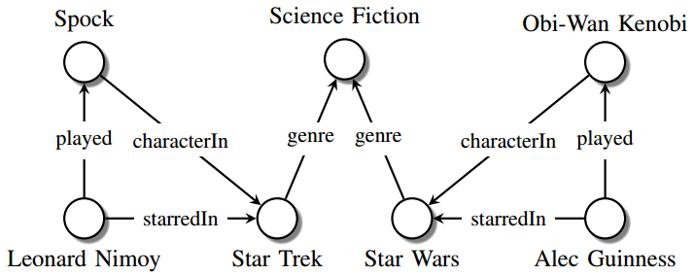
Why?

Slide 4
Books
Ian Sommerville – Software Engineering 10th Edition
Roger Pressman – A practitioner’s Approach 7th Edition

Slide 5
What is Success of a Software?
When it meets the needs of the people who use it
When it performs flawlessly over a long period of time
When it is easy to modify
Easier to use

Slide 6
What do people use software for?

Slide 7
What happens if a software is not successful?
Customer dissatisfaction
Loss of financial assets
Loss of human lives
One may have to face avoidable legal consequences as you or your company could be sued for damages or injuries caused by bugs in you software.

Slide 8
Software Engineering: Definition
Software Engineering is a collection of techniques,
methodologies and tools that help
with the production of
a high quality software system
with a given budget
before a given deadline
while change occurs.
Bernd Bruegge & Allen H. Dutoit Object-Oriented Software Engineering: Using UML, Patterns, and Java
20

Slide 9
Software engineering exists as a discipline because much software fails to be delivered when expected or to perform as expected.
The first step to controlling these problems is to understand them. Once the modes of failure are understood, the deficiencies in existing software can be addressed.
http://www.bernstein-plus-sons.com/.dowling/CSC175/SE_Failures.html

Slide 10
Scientist vs Engineer
Computer Scientist
  Proves theorems about algorithms, designs languages, defines knowledge representation schemes
  Has infinite time…
Engineer
  Develops a solution for an application-specific problem for a client
  Engineering is all about developing products, using well defined, scientific principles and methods.
  Uses computers & languages, tools, techniques and methods
Software Engineer
  Works in multiple application domains
  Has only 3 months...
  …while changes occurs in requirements and available technology
Bernd Bruegge & Allen H. Dutoit Object-Oriented Software Engineering: Using UML, Patterns, and Java
Notes:
A computer scientist assumes that techniques, methodologies and tools are to be developed. They investigate in designs for each of these weapons, and prove theorems that specify they do what they are intended to do. They also design languages that allow us to express techniques. To do all this, a computer scientist has available an infinite amount of time.
A software engineering views these issues as solved. The only question for the software engineer is how these tools, techniques and methodologies can be used to solve the problem at hand. What they have to worry about is how to do it under the time pressure of a deadline. In addition they have to worry about a budget that might constrain the solution, and often, the use of tools. Good software engineering tools can cost up to a couple of $10,000 Dollars (Galaxy, Oracle 7, StP/OMT)
Object modeling is difficult. As we will see, good object modeling involves mastering complex concepts, terminology and conventions. It also requires considerable and sometimes subjective expertise in a strongly experience-based process. Beware of the false belief that technology can substitute for skill, and that skill is a replacement for thinking. offers this advise [cit Tillmann].
Many organizations are frustrated with a lack of quality from their tool-based systems. However, the cause of this problem is often the false belief that a tool can be a substitute for knowledge and experience in understanding and using development techniques. Although CASE tools such as StP/OMT or Objectory and similar tools have the potential to change how people design applications, it is a mistake to think they can replace the skills needed to understand and apply underlying techniques such as object, functional or dynamic modeling. You cannot substitute hardware and software for grayware (brain power) [cit Tillmann]: Buying a tool does not make a poor object modeler a good object modeler. Designers need just as much skill in applying techniques with CASE tools as they did with pen and paper.
Another problem, that is often associated with tool-based analysis is that it is often insufficient or incomplete. Why is that? To a certain extent this problem has always existed. Systems developers are much better at collecting and documenting data than they are at interpreting what these data mean. This in unfortunate, because the major contribution an analysist can bring to system development is the thought process itself. But just as a tool is not a substitute for technique, knowledge and experience, technique skills cannot replace good analysis - people are still needed to think through the problem.
So our message is: Being able to use a tool does not mean you understand the underlying techniques, and understanding the techniques does not mean you understand the problem. In the final analysis, organizations and practitioners must recognize, that methodologies, tools and techniques do not represent the added values of the object modeling process. Rather, the real value that is added, is the thought and insight that only the analyst can provide.

Slide 11
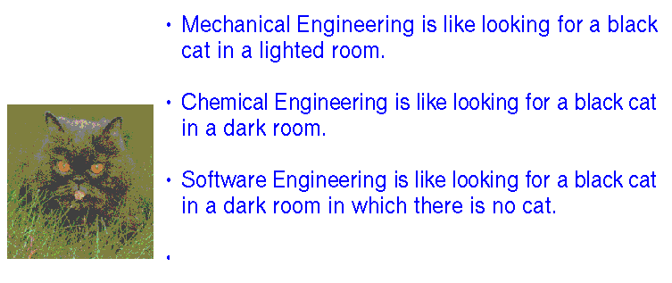
http://sven-s.blogspot.com/2006/04/black-cats-and-software-engineering.html

Slide 12
The Intangible nature of software causes problems for management in planning, estimating, scheduling and budgeting for accounting purposes.

Slide 13
Types of Software Products
Generic products
  Stand-alone systems that are marketed and sold to any customer who wishes to buy them.
  Examples – Word Processors, graphics programs, Information systems, ERPs
Customized products
  Software that is commissioned by a specific customer to meet their own needs.
  Examples – embedded control systems, air traffic control software, NADRA software
The difference between the FR and NFR between both

Slide 14
“Engineering”
Engineering is the application of knowledge, typically in the form of science, mathematics, and empirical evidence, to the innovation, design, construction, operation and maintenance of structures, machines, materials, devices, systems, processes, and organizations.
Practical use, economic value: These products need to help people do the things they need to do that customers actually want and are willing to pay real money for.
Responsibility for correctness, suitability, and safety.

Slide 15
What is Software Engineering?
Software engineering (SE) is the application of a systematic, disciplined, quantifiable approach to the design, development, operation, and maintenance of software, and the study of these approaches; that is, the application of engineering to software.
  Wikipedia
[Software engineering is] the establishment and use of sound engineering principles in order to obtain economically software that is reliable and works efficiently on real machines.
  Fritz Bauer
Software Engineering: (1) The application of a systematic, disciplined, quantifiable approach to the development, operation, and maintenance of software; that is, the application of engineering to software. (2) The study of approaches as in (1).
  IEEE
One of the most pointless principles in the field of computer science. Entails nothing but common sense applied to programming, and generally takes up too much of your time to create stupid diagrams so people less intelligent than yourself can understand how it fits together.
  Urbandictionary.com

Slide 16
In short, Software engineering is a branch of computer science, which uses well defined engineering concepts required to produce efficient, durable, scalable, in budget, and on-time software products. It is concerned with all aspects of software production, from the early stages of system specification through to maintaining the system after it has gone into use.
The first reference to the term is the 1968 NATO Software Engineering Conference and was meant to provoke thought regarding the perceived "software crisis" at the time.

Slide 17
The Process
Modeling
Quality Management
Project Management techniques

Slide 18
Software Crisis
Software crisis was a term used in the early days of computing science.
The term was used to describe the impact of rapid increases in computer power and the complexity of the problems that could be tackled.
The focus of development and innovation was on hardware. Software was largely viewed as an afterthought.
A study in United States (1979) found that:
  2% of software worked on delivery
  3% worked only after some corrections
  45% were delivered, but never successfully used
  20% were used, only after major modification/rework
  30% were paid for, but never completed/delivered
  Software Engineering
  By: Jibitesh Mishra; Ashok Mohanty

Slide 19
Software Crisis (cont…)
Systems cost exceeded the initial estimated budget
Software over-ran delivery schedules
Software had to be substantially modified
Projects were unmanageable and code difficult to maintain.
Software was never delivered.
  These problems of software development were extensively felt in the beginning of the 1970s and are collectively referred to as the "software crisis".

Slide 20
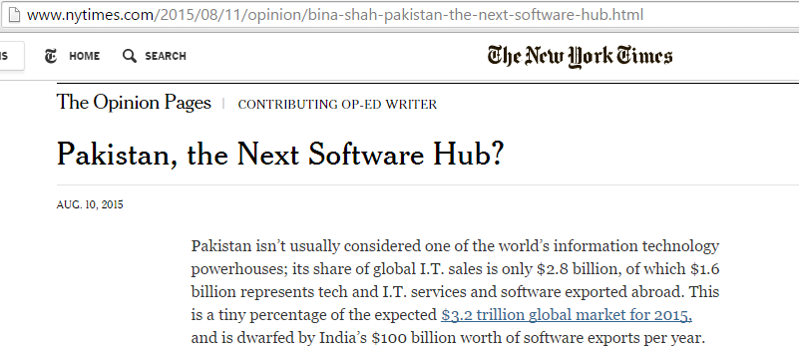

Slide 21
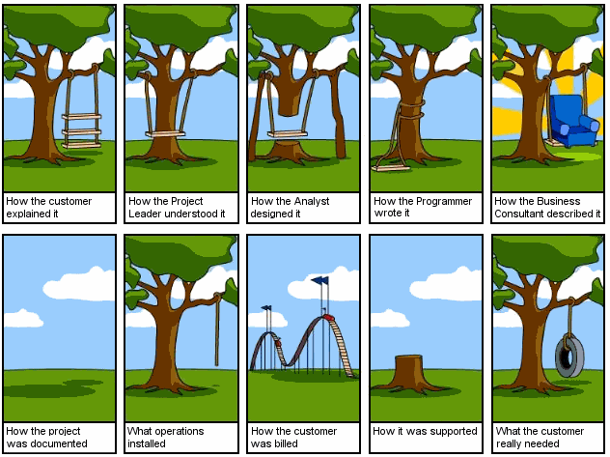

Slide 22
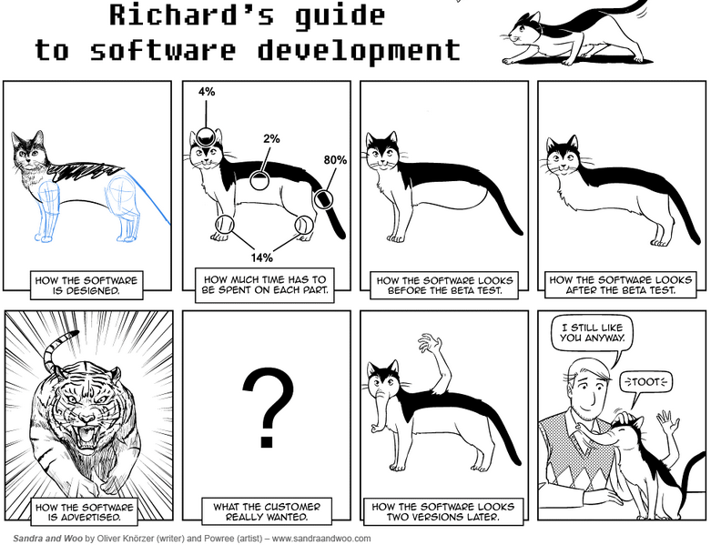

Slide 23
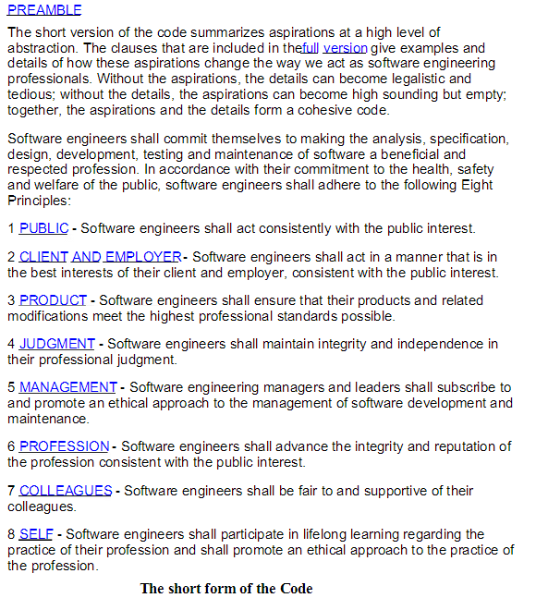
Software engineering code of ethics (ACM/IEEE-CS Joint Task Force on Software Engineering, 1999)

Slide 24
http://sven-s.blogspot.com/2006/04/black-cats-and-software-engineering.html

Slide 25
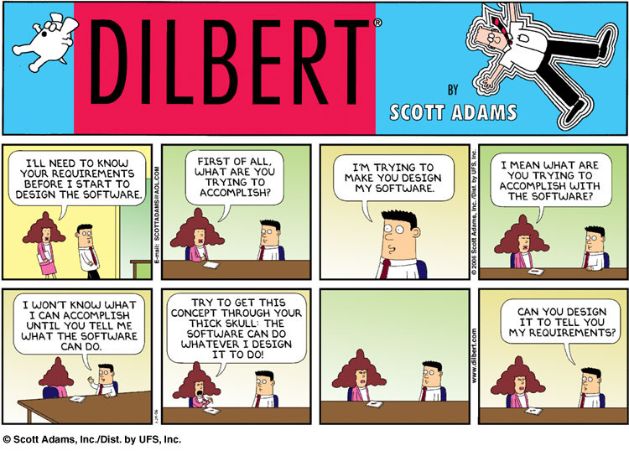
Requirement gathering

Slide 26
Some famous software issues
Year 2038 Bug: It is possible a problem (similar to Y2K) could occur in 2038 (the year 2038 problem), as many Unix systems calculate the time in seconds since 1 January 1970, and store this number as a 32-bit signed integer, for which the maximum possible value is 231 − 1 (2,147,483,647) seconds
The Therac-25 was a radiation therapy machine produced by Atomic Energy of Canada Limited (AECL). It was involved in at least six accidents between 1985 and 1987, in which patients were given massive overdoses of radiation, approximately 100 times the intended dose.
The accidents occurred when the high-power electron beam was activated instead of the intended low power beam, and without the beam spreader plate rotated into place. Previous models had hardware interlocks in place to prevent this, but Therac-25 had removed them, depending instead on software interlocks for safety.

Slide 27
Boeing 737 max
“Investigators link both crashes, in part, to an automated flight control system that acted on erroneous information from malfunctioning sensors and put the planes into nose dives the pilots could not pull the planes out of.”
https://www.npr.org/2019/06/26/736430419/faa-finds-new-problem-with-737-max-jets-delaying-their-return-to-flight

Slide 28
Virtual Case File (or VCF) was a software application developed by the United States Federal Bureau of Investigation (FBI) between 2000 and 2005. The project was officially abandoned in April 2005, while still in development stage and cost the federal government nearly $170 million.

Slide 29
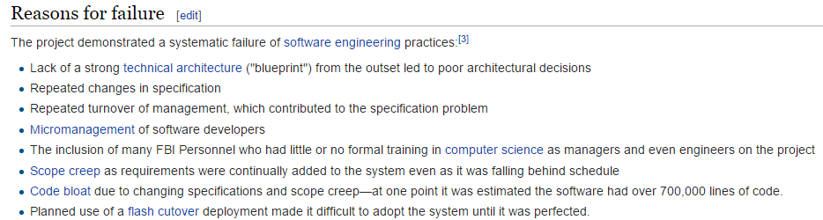

Slide 30
Why so many issues?
Requirement of flexibility
  So flexible that start working with it before fully understanding what needs to be done.
  Unknowns
  Changes – policies, requirements, technologies.
Intangibility/ Invisibility
  Interfaces undecided
  Transient hardware, software errors, race conditions, compatibility issues.
  Visualization (E.g. The program for calculating landing for path finder mission)
Conformity
  Systems usually interacts with outside systems.

Slide 31
Issues with your projects?
What are the issues you have faced in your projects?

Slide 32
Although the industry is moving toward component-based construction, most software continues to be custom-built.

Slide 33
Software – Some Categories
Legacy Software
Open world computing—pervasive, ubiquitous, distributed computing due to wireless networking. How to allow mobile devices, personal computer, enterprise system to communicate across vast network.
Netsourcing—the Web as a computing engine. How to architect simple and sophisticated applications to target end-users worldwide.
Open source—”free” source code open to the computing community (a blessing, but also a potential curse!)
Data mining
Grid computing
Cognitive machines
Software for nanotechnologies

Slide 34
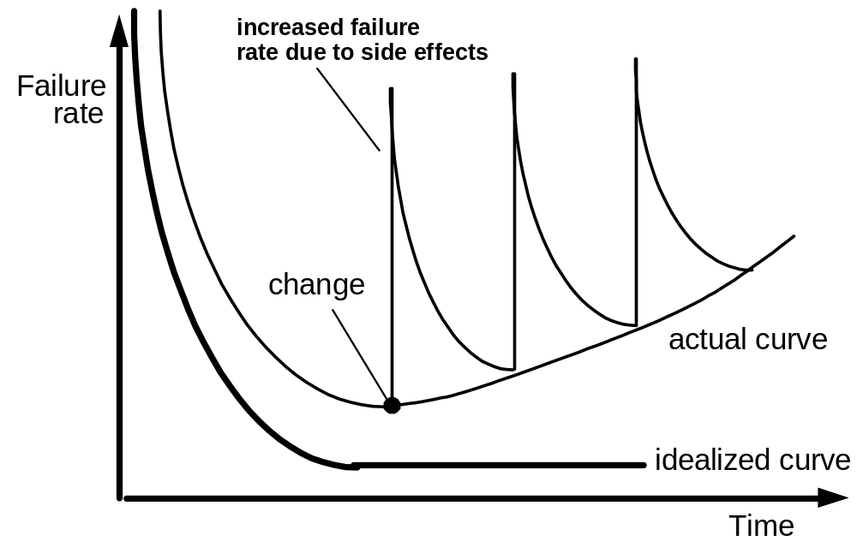
S.W. Deterioration

Slide 35
Some Realities
a concerted effort should be made to understand the problem before a software solution is developed
design becomes a pivotal activity
software should exhibit high “quality”
software should be “maintainable”

Slide 36
Software Engineering Layers
tools
methods
Process model
Quality focus

Slide 37
Course Description

Slide 38
Course Objectives
At the end of this course, students should:
Have a sound understanding of the fundamental concepts of the software engineering paradigm.
Understand and apply the different common practices used in software industry for the analysis, design and production of software.
Analyze, design and implement practical systems of up to average complexity within a team.
Become familiar with different tools used by industry in the software development process.
Be prepared for interviews.

Slide 39
Tentative
Assignment | 10
Quiz | 5
Project | 20
Mids | 25
Final | 40

Slide 40
A process is a collection of activities, actions, and tasks that are performed when some work product is to be created. The software process forms the basis for management control of software projects and establishes the context in which technical methods are applied, work products (models, documents, data, reports, forms, etc.) are produced, milestones are established, quality is ensured, and change is properly managed.
Software engineering methods provide the technical how-to’s for building software. Methods encompass a broad array of tasks that include communication (e.g. interviews, questionnaires), requirements analysis, design modeling, program construction, testing, and support. Software engineering methods rely on a set of basic principles that govern each area of the technology and include modeling activities and other descriptive techniques.
Software engineering tools provide automated or semiautomated support for the process and the methods.

Slide 41
The Essence of Software Engineering
Understand the Problem (Communication and Analysis)
Plan a solution (Modeling and Software Design)
Carry out a plan (Code generation)
Examine the result for accuracy (Testing and Quality Assurance)

Slide 42
Understanding the Problem
Who has a stake in the solution to the problem? That is, who are the stakeholders?
What are the unknowns? What data, functions, and features are required to properly solve the problem?
Can the problem be compartmentalized? Is it possible to represent smaller problems that may be easier to understand?
Can the problem be represented graphically? Can an analysis model be created?

Slide 43
Plan a Solution
Have you seen similar problems before? Are there patterns that are recognizable in a potential solution? Is there existing software that implements the data, functions, and features that are required?
Has a similar problem been solved? If so, are elements of the solution reusable?
Can subproblems be defined? If so, are solutions readily apparent for the subproblems?
Can you represent a solution in a manner that leads to effective implementation? Can a design model be created?

Slide 44
Carry Out the Plan
Develop a solution.
Does the solution conform to the plan? Is source code traceable to the design model?
Is each component part of the solution provably correct? Have the design and code been reviewed, or better, have correctness proofs been applied to the algorithm?

Slide 45
Examine the Result
Is it possible to test each component part of the solution? Has a reasonable testing strategy been implemented?
Does the solution produce results that conform to the data, functions, and features that are required? Has the software been validated against all stakeholder requirements?

Slide 46
Types of Stakeholders
Primary Stakeholders - usually internal stakeholders, are those that engage in economic transactions with the business. (For example stockholders, customers, suppliers, creditors, and employees)
Secondary Stakeholders - usually external stakeholders, are those who - although they do not engage in direct economic exchange with the business - are affected by or can affect its actions. (For example the general public, communities, activist groups, business support groups, and the media)
-wikipedia

Slide 47
Stakeholders
A person, group or organization that has interest or concern in an organization.
Possible Stakeholders:
  Government taxation, legislation, employment, legalities.
  Employees job security, compensation
  Customers value, quality, customer care
  Suppliers providers of products and services used in the end product for the customer
  Creditors credit score, new contracts, liquidity (banks?).
  Community jobs, involvement, environmental protection, shares, truthful communication.
  Trade Unions quality, worker protection, jobs.
  Owner(s) profitability, longevity, market share, market standing, succession planning, raising capital, growth, social goals.
  Investors return on investment, income.

Slide 48
FAQs
Question | Answer
What is software? | Computer programs, data structures and associated documentation. Software products may be developed for a particular customer or may be developed for a general market.
What are the attributes of good software? | Good software should deliver the required functionality and performance to the user and should be maintainable, dependable and usable.
What is software engineering? | Software engineering is an engineering discipline that is concerned with all aspects of software production.
What is the difference between software engineering and computer science? | Computer science focuses on theory and fundamentals; software engineering is concerned with the practicalities of developing and delivering useful software.
What is the difference between software engineering and system engineering? | System engineering is concerned with all aspects of computer-based systems development including hardware, software and process engineering. Software engineering is part of this more general process.

